Slide 1


CSA0764 – COMPUTER NETWORK FOR GAME SERVER
Development of ICMP-Based Tools for Effective Network Diagnostics and Troubleshooting
By
Lathika Chowdry S (192512286)
Shalini K (192512270)
Srenidhi M S (192511214)
Under the guideance of
Dr.Senthil K & Dr.Rjaram P

Slide 2


Introduction
Importance of network diagnostics in modern communication systems
Role of ICMP (Internet Control Message Protocol) in monitoring network health
ICMP as a core protocol used for error reporting and status checking
Overview of project focus: diagnostics + ICMP protocol implementation
ICMP serves as a fundamental tool for testing connectivity and identifying network performance issues in real time.

Slide 3
Objectives
To study the working principles of the ICMP protocol
To implement ICMP-based diagnostics tools (Ping, Traceroute, etc.)
To analyze network connectivity using ICMP messages
To implement ICMP protocol functionalities programmatically
To evaluate the performance and accuracy of ICMP-based tools

Slide 4
Literature Review
Author and Year | Methodology | Key Findings | Title of the paper
Cisco Systems, 2022 | Technical documentation and analysis of ICMP Echo, Echo Reply, Time Exceeded messages used in ping and traceroute. | ICMP helps detect reachability, latency, packet loss, and hop-by-hop routing behaviour. | Understanding the Ping and Traceroute Commands
FreeCodeCamp, 2021 | Step-by-step demonstration of ICMP diagnostic tools (ping, traceroute) with practical examples. | ICMP is the simplest and fastest way to test reachability and latency. | How to Use Ping and Traceroute (Beginner's Guide)
Network Forensics Group (IJAET), 2018 | Forensic analysis of ICMP error packets and behaviour under network faults. | ICMP error types provide strong indicators of routing failures, MTU issues, and unreachable hosts. | Network Forensics Using ICMP Protocol”

Slide 5
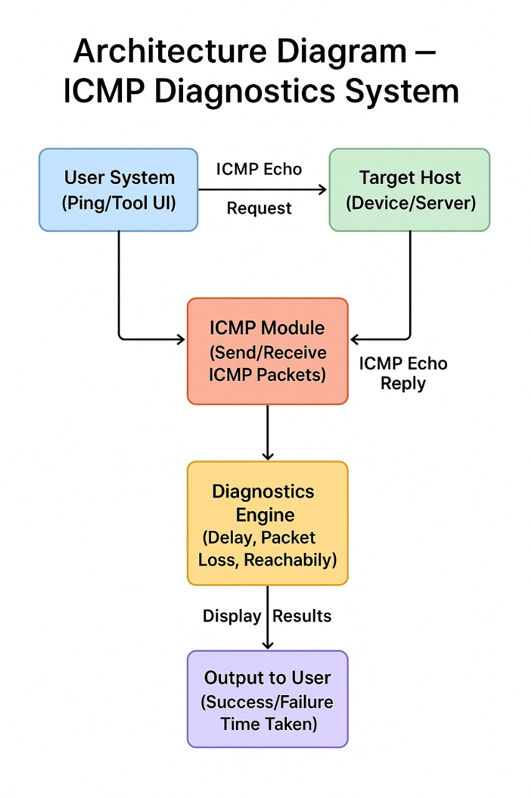
Architecture Diagram
High-level architecture of ICMP communication
Flow: Host → ICMP Echo Request → Destination → Echo Reply
Module 1: Diagnostics Layer (Ping, Traceroute logic)
Module 2: Protocol Layer (Building & sending raw ICMP packets)
Data capture using packet sniffing tools (e.g., Wireshark)Error handling and response interpretation

Slide 6
Methodology
Study and analysis of ICMP message structure
Designing two modules:
ICMP Diagnostics Implementation Module
ICMP Protocol Implementation Module
Tools used: Wireshark, Linux command-line utilities, programming language APIs
Testing on different network environments (LAN/WAN)Recording results and evaluating performance

Slide 7
ICMP Diagnostics Implementation Module-1
Implementation of Ping functionality
RTT (Round Trip Time) calculation
Packet loss monitoring
Hop-by-hop route tracing logic (Traceroute)
TTL manipulation to identify network paths
Logging and visualization of diagnostic results

Slide 8
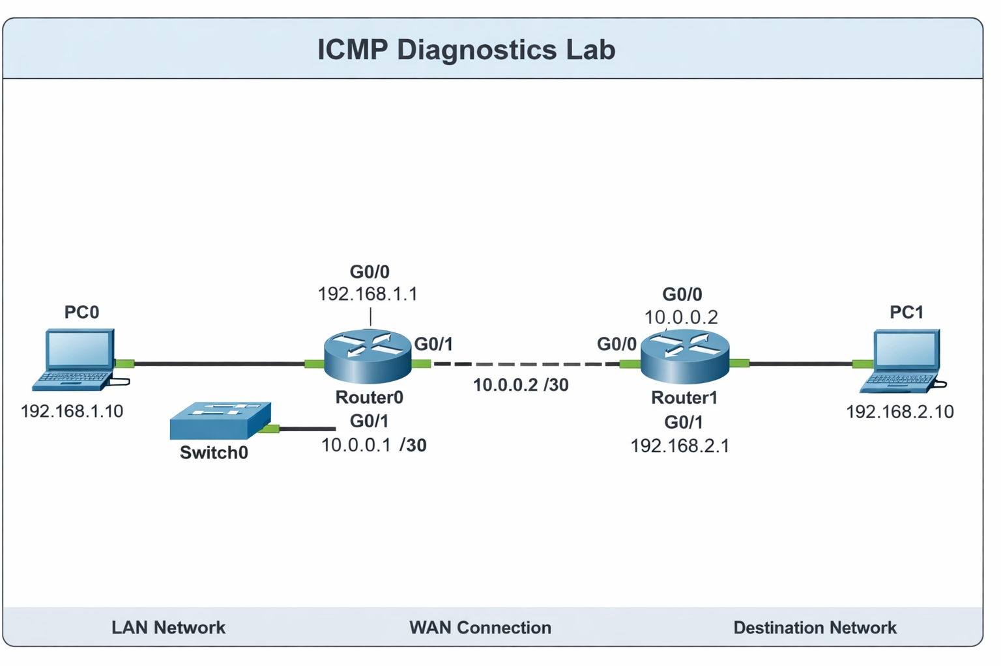

Slide 9
ICMP Protocol Implementation Module - 2
Construction of ICMP packets using raw sockets
Encoding ICMP headers (Type, Code, Checksum)
Generating Echo Request & parsing Echo Reply
Implementing checksum calculation
Handling timeouts and errors
Interaction between protocol and diagnostics modules

Slide 10
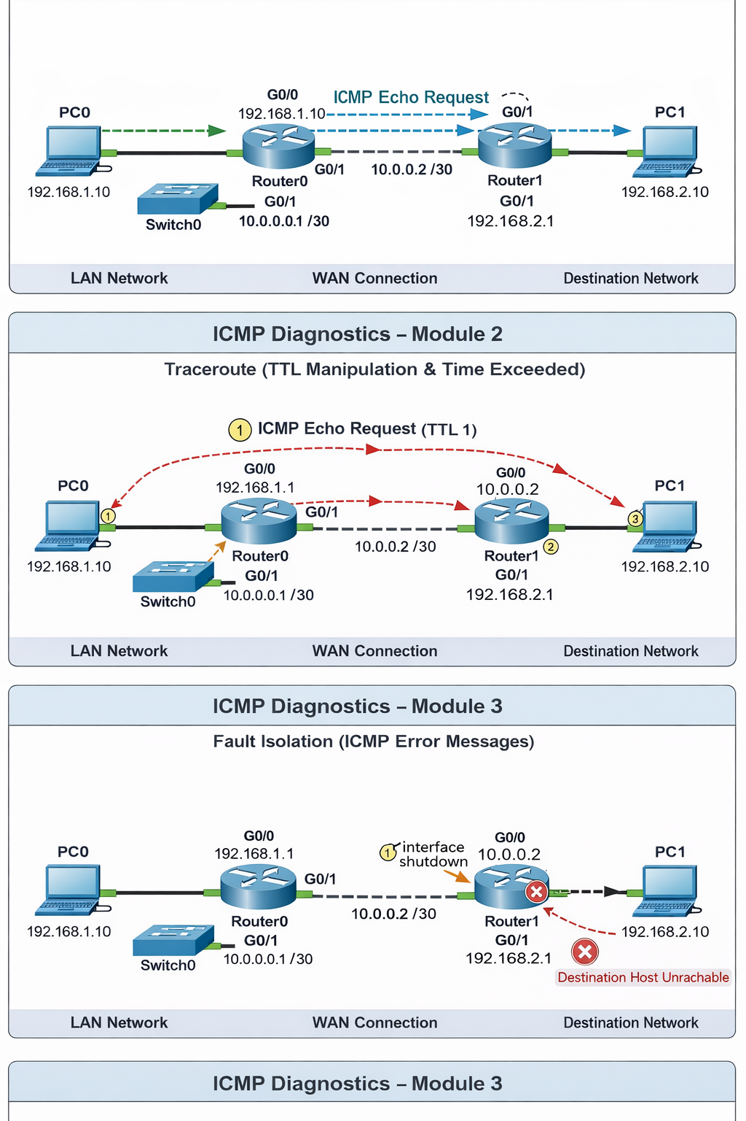

Slide 11
ICMP for Network Fault Isolation
Module - 3
Uses ICMP messages to identify and locate network faults.
Analyzes ICMP error types and codes (Destination Unreachable, Time Exceeded, Redirect).
Performs hop-by-hop route analysis using Traceroute.
Detects faulty or slow network nodes by observing RTT variations.
Identifies packet drops and unreachable hosts through ICMP responses.
Differentiates between link failure, router failure, and congestion issues.
Correlates packet loss with specific network hops.

Slide 13
Results and Discussion
Output from Ping and Traceroute tests
Performance of custom ICMP packet implementation
Analysis of RTT, packet loss, hop discovery
Comparison with default system tools
Interpretation of packet captures from Wireshark

Slide 14
Challenges and Limitations
Raw socket access restrictions on some systems
ICMP traffic blocking by firewalls
Network latency variations affecting results
Difficulty in tracing routes over secured networks
ICMP not suitable for large data communication
Dependence on router configurations for hop detection

Slide 15
Conclusion
ICMP remains a vital protocol for network diagnostics
Implemented modules successfully demonstrate ICMP operations
Diagnostic tools help identify connectivity issues effectively
Project contributes to understanding network behavior through ICMP
The project demonstrates the reliability of ICMP as a lightweight diagnostic protocol across different network conditions.
Overall, the work enhances foundational networking knowledge and prepares for advanced protocol analysis in future studies.

Slide 16
References
Bonica et al., “ICMP: Standards & Operational Experience,” IETF Draft, 2024.
Feng et al., “Off-Path Attacks on TCP/IP,” arXiv, 2024.
Sharma et al., “DDoS Detection in UAVs,” arXiv, 2024.
Radhakrishnan, “ICMP Flood Detection in IoT,” IJHRMOB Journal, 2023.
Sapkota et al., “Attack Detection in SDN (ICMP Floods),” MDPI, 2025.
Almadhor et al., “DDoS Detection in IoT Networks,” Scientific Reports, 2024.

Slide 17
THANK YOU

